Slide 1
Network Traffic Analysis
Exploring Apache SPOT http://spot.apache.org/

Slide 2
Quick-Links
http://kudu-mk-1.vpc.cloudera.com:8888/

Slide 3
What is Apache SPOT?
Formerly known as ONI
Initiative of Cloudera, Intel, and partners
Focus on Cybersecurity
Common data formats
Reliable and robust data pipelines
Repeatable and reliable analysis and modeling procedures

Slide 4
Ingestion …
More details will be taken from ”Application team”

Slide 5
ONI-ML
Implementation of LDA algorithm on 3 data sources:
PROXY
DNS
NETFLOW

Slide 6
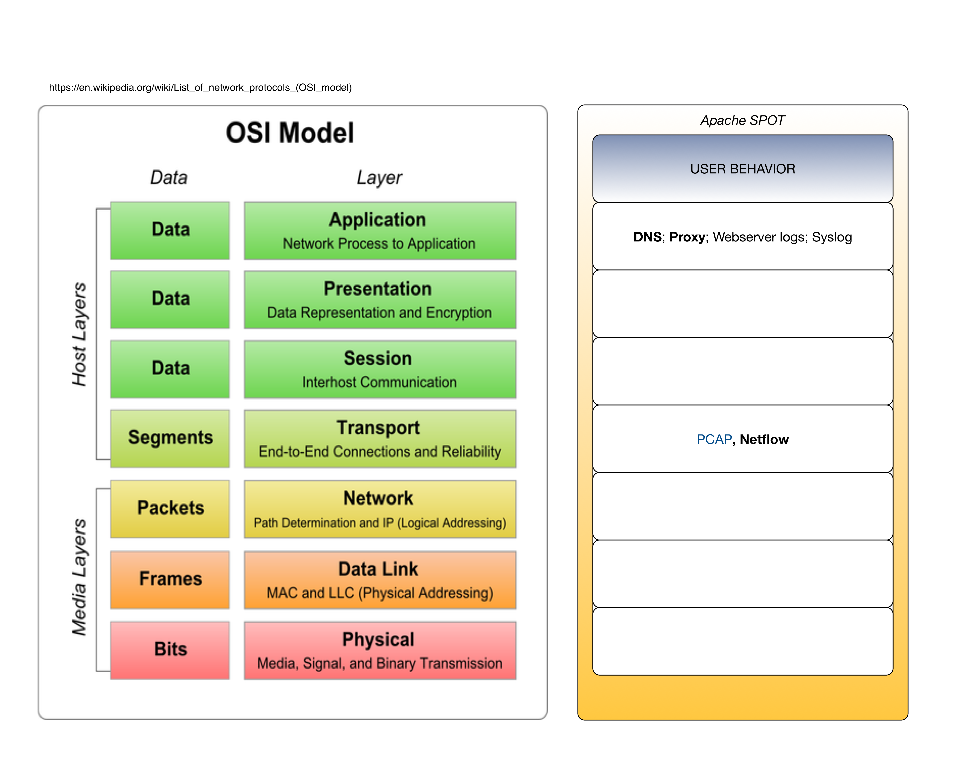

Slide 7
The Data Formats (1) : DNS

Slide 8
The Data Formats (2) : PROXY

Slide 9
The Data Formats (3) : NETFLOW

Slide 10
LDA: What and Why?

Slide 11
Our Goals (long term):
Use local context information instead of single package data only.
(A) Vectorization of measured properties
(B) Temporal communication networks
Consider additional communication layers:
Syslog
Webserver log
Cloudera Manager events
Cloudera Navigator events

Slide 12
Our Activities
Implement a data pipeline:
Kafka => Spark => HDFS => Notebook
Kafka => Spark => Kudu
Kudu => Spark => HDFS => (Notebook)
Create reference data sets
Scenario A: Terrasort (Big-Batch-Workload)
Scenario B: HDFS PUT,GET; HUE (Interactive Workload)
Scenario C: Idle cluster (Vacation time)
Scenario D: Kafka => Spark => Kudu (Realistic production Workload)
Scenario E: Twitter => Spark => Kudu (Realistic production Workload)

Slide 13
About Event Processing:
Kafka gives an order only within a partition
Post-processing in Spark
HBase sorts rows by key
Table design is now strictly time related, which is not a very universal approach.
Kudu uses Primary Keys Each Kudu table must declare a primary key comprised of one or more columns. Primary key columns must be non-nullable, and may not be a boolean or floating-point type. Every row in a table must have a unique set of values for its primary key columns. As with a traditional RDBMS, primary key selection is critical to ensuring performant database operations.
But: Events have timestamps which are not really unique !!!

Slide 14
Scenario A:
TERRAGEN
TERRASORT

Slide 15
Test Data for Scenario B:
KDD Cup data set (see Sean's Book - chap.5) in:
node: kudu-mk-5.vpc.cloudera.com path: /root/kddcup.data
Downloaded from: http://kdd.ics.uci.edu/databases/kddcup99/kddcup99.html

Slide 16
Test Data for Scenario C:

Slide 17
Scenario D:
IDLE CLUSTER (some unknown activity in the
background)

Slide 19
Test Data for Scenario E:

Slide 20
K-Means

Slide 21
Entropy of Temporal Network
Time evolution of the network properties
Topology
Topological node properties

Slide 22
Word Shift Graph
Model stability over time

Slide 23
Kafka Setup
Which topics do we need?
Auto—topic generation is not recommended

Slide 24
Milestone One:
Follow a common DSP model (data science process model)
Use CDH default tools and gain experience
Work with Kafka (for input) and Hive tables (for input and output)
Implement a dataset profiling procedure, using Spark
Present results, using Jupiter notebook
Increase functionality and knowledge by doing small iterations
Share code and knowledge

Slide 25
Our Results:
We organized our work in 3 phases:
Data and domain inspection + solution proposals
Environment setup
Tool centric: Jupyter, Eclipse, IntlliJ, CloudCat cluster, Git repository
Data centric:, Data collector tool, Demo data generation, Data formats
Data capturing and data generation
Analyzing the data in a well defined environment
Results are available in Git repos:
http://github.mtv.cloudera.com/kamir/Snaffer
https://github.com/mbalassi/packet-inspector
…
Increase functionality and knowledge by doing small iterations
Share code and knowledge

Slide 26
TODO (1)
Define data sources according to inspection methods
Define Avro schema and SOLR schema
Automatic dataset initalization / validation
DESCRIBE as WIKI and than instantiate via ANSIBLE

Slide 27
TODO (2)
SNAProfiler
SQL for Network creation
Topology per time slice
Envelop:
Allows us to hook in the SNAProfiler component as a JAR.

Slide 28
TODO (3)
Time Slice Preparation
KAFKA => Hbase
App—controled time slice management:
(K,V) : (EXP_METRIC_TS, NETWORKDATA_as_edgelist)
Opposite to TIMESERIES presentation

Slide 29
References
https://docs.google.com/document/d/12SHvTGJWtewk8CpUClOy22mh7cUow18F_Jg2ZNNE3h8/edit#heading=h.r4wlzr2ctack
https://docs.google.com/document/d/1sD0_T2fQ7J5k7Ttx1vmAkYkMljMySgKFimm4hNVXxgA/edit#
http://research.ijcaonline.org/volume74/number17/pxc3890233.pdf
https://www.cs.princeton.edu/~blei/papers/BleiNgJordan2003.pdf

